Slide 1
1.Uncertainty
Consider the following disease detection problem:
According to the data in the table, if we have a patient with both symptoms:
What is the predicted class taking into account only the prioris?
What is the predicted class using the maximum likelihood (ML) criterion?
What is the predicted class using MAP?
Let’s build a Naive Bayes classifier using the data in the table:
What is the main assumption Naïve Bayes makes?
What are the estimates of the posterior probabilities according to Naïve Bayes, and what class would be predicted?
Symptom 1 | Symptom 2 | Disease
yes | no | no
yes | no | no
no | yes | no
yes | no | no
no | no | yes
no | no | yes
no | yes | yes
yes | yes | yes

Slide 2

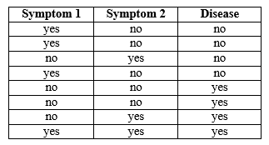
if we have a patient with both symptoms
What is the predicted class taking into account only the prioris?
P(disease=no) = P(disease)
The prior probability of disease=Yes is equal to the probability of disease=No, so both are equally probable.
What is the predicted class using the maximum likelihood (ML) criterion?
P(symptom 1,symptom 2 | disease=no) =
= #(symp.1,symp.2,disease=no) / #(disease=no) = 0/4
P(symptom 1,symptom 2 | disease=yes) =
= #(symp.1,symp.2,disease=yes) / #(disease=yes) = 1/4
ML decides disease=yes,which has the highest likelihood
What is the predicted class using MAP?
P(disease=no | symptom 1,symptom 2) =
= #(symp.1,symp.2,disease=no) / #(symptom1,symptom2) = 0 / 1
P(disease=yes | symptom 1,symptom 2) =
= #(symp.1,symp.2,disease=yes) / #(symptom1,symptom2) = 1 / 1
MAP decides disease=yes, which has the highest posterior probability

Slide 3
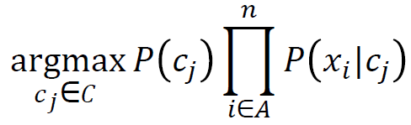

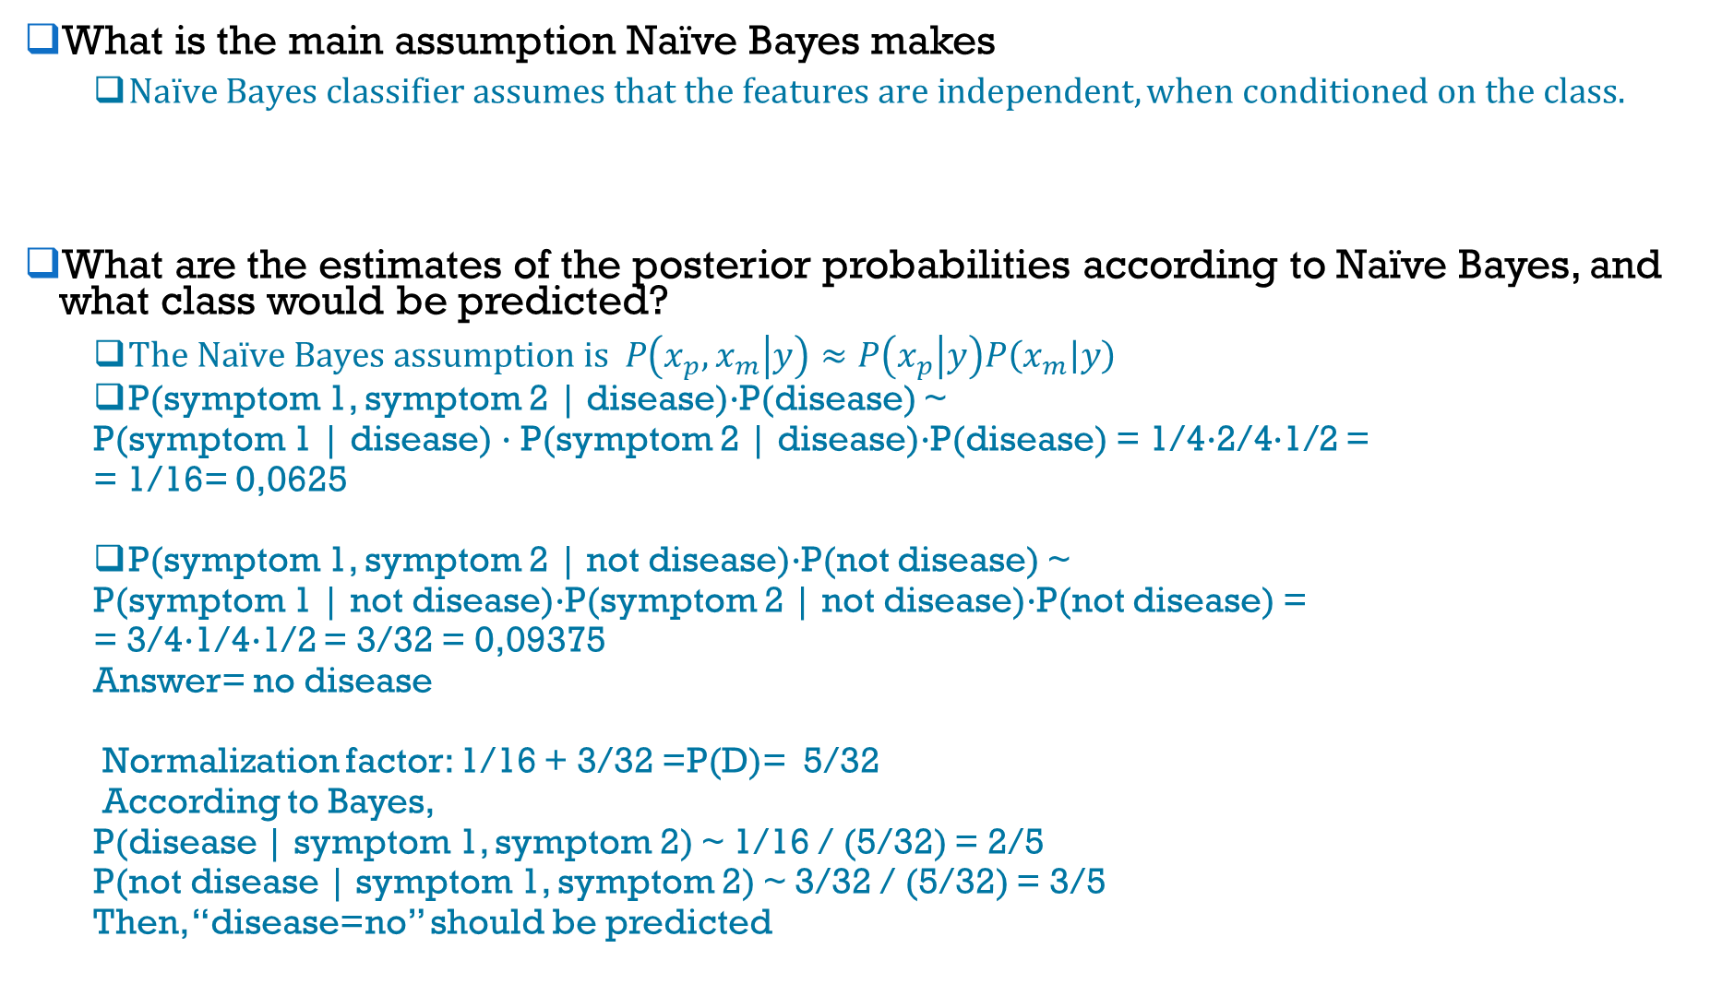
What is the main assumption Naïve Bayes makes
$Naïve Bayes classifier assumes that the features are independent, when conditioned on the class.$
What are the estimates of the posterior probabilities according to Naïve Bayes, and what class would be predicted?
$The Naïve Bayes assumption is P\left(x_{p},x_{m} | y\right)≈P\left(x_{p} | y\right)P\left(x_{m} | y\right)$
P(symptom 1, symptom 2 | disease)·P(disease) ~
P(symptom 1 | disease) · P(symptom 2 | disease)·P(disease) = 1/4·2/4·1/2 =
= 1/16= 0,0625
P(symptom 1, symptom 2 | not disease)·P(not disease) ~
P(symptom 1 | not disease)·P(symptom 2 | not disease)·P(not disease) =
= 3/4·1/4·1/2 = 3/32 = 0,09375
Answer= no disease
Normalization factor: 1/16 + 3/32 =P(D)= 5/32
According to Bayes,
P(disease | symptom 1, symptom 2) ~ 1/16 / (5/32) = 2/5
P(not disease | symptom 1, symptom 2) ~ 3/32 / (5/32) = 3/5
Then, “disease=no” should be predicted
Naive Bayes
Bayes theorem

Slide 4
2. Probability and Bayesian networks
The prevalence of a rare disease is one person every 10,000 people. You have some symptoms that indicate that you may have the disease. Your get tested and the outcome of the test is positive.
The test is fairly reliable:
If you have the disease, the outcome is positive with 99 percent probability.
If you do not have the disease, the outcome is negative with 95 percent probability.
With this information
What is the probability of your having the disease?
Besides having tested positive you have also a fever over 41º (symptom F) and a dry cough (symptom C).
The probability of having such a high fever when you have the disease is 95%.
The probability of having such a high fever when you do not have the disease is 0.1%.
The probability of having a dry cough when you have the disease is 60%.
The probability of having a dry cough when you do not have the disease is 1%.
The probability of having have a dry cough when you have a high temperature and have the disease is 90%.
The probability of having have a dry cough when you have a high temperature and do not have the disease is 40%.
What was the probability of your having had the disease today given the results of your test and your symptoms using Naïve Bayes?
Assume that when you know whether you have the disease or not, the following conditional independence relations hold:
The result of the test is independent of whether or not you have any symptoms.
Whether or not you have a high temperature is independent of whether or not you have a dry cough and of the result of the test.
Whether or not you have a dry cough depends on whether or not you have high temperature. It is independent of the result of the test.
With this assumption
Draw the diagram that represents the factorization of the likelihood.
What was the probability of your having the disease?
In this graphical model, is the probability of having the disease lower, equal, or higher than in Naïve Bayes? Why?

Slide 5
The prevalence of a rare disease is one person every 10,000 people. You have some symptoms that indicate that you may have the disease. Your get tested and the outcome of the test is positive.
P(D) = 0.0001; P(¬D) = 0.9999
The test is fairly reliable:
If you have the disease, the outcome of the test is positive with 99 percent probability.
P( + | D) = 0.99; P( - | D) = 0.01
If you do not have the disease, the outcome of the test is negative with 95 percent probability.
P( - | ¬D) = 0.95; P( + | ¬D) = 0.05
Besides having tested positive you have a fever over 41º (symptom F) and a dry cough (symptom C) as well.
The probability of having such a high fever when you have the disease is 95%.
P( F | D) = 0.95; P( ¬F | D) = 0.05
The probability of having such a high fever when you do not have the disease is 0.1%.
P( F | ¬D) = 0.001; P( ¬F | ¬D) = 0.999
The probability of having a dry cough when you have the disease is 60%.
P( C | D) = 0.60; P( ¬C | D) = 0.40
The probability of having a dry cough when you do not have the disease is 1%.
P( C | ¬D) = 0.01; P( ¬C | ¬D) = 0.99
The probability of having a dry cough when you have a high temperature and have the disease is 90%.
P( C | F, D) = 0.90; P( ¬C | F, D) = 0.10
The probability of having a dry cough when you have a high temperature and do not have the disease is 40%.
P( C | F, ¬D) = 0.40; P( ¬C | F, ¬D) = 0.60

Slide 6
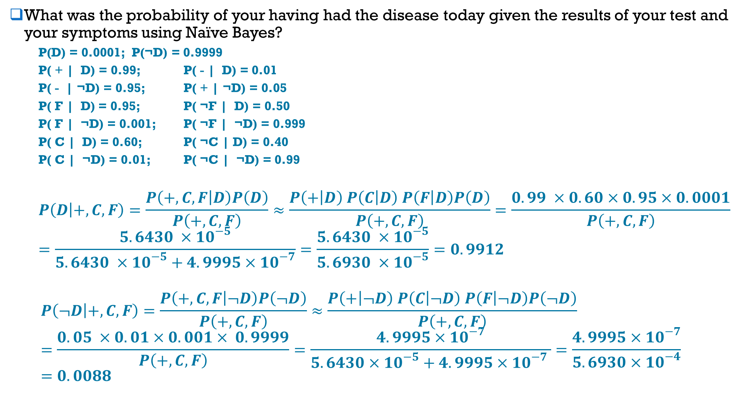
What was the probability of your having had the disease today given the results of your test and your symptoms using Naïve Bayes?
P(D) = 0.0001; P(¬D) = 0.9999
P( + | D) = 0.99; P( - | D) = 0.01
P( - | ¬D) = 0.95; P( + | ¬D) = 0.05
P( F | D) = 0.95; P( ¬F | D) = 0.50
P( F | ¬D) = 0.001; P( ¬F | ¬D) = 0.999
P( C | D) = 0.60; P( ¬C | D) = 0.40
P( C | ¬D) = 0.01; P( ¬C | ¬D) = 0.99
$$P\left(D | +,C, F\right)=\frac{P\left(+,C,F | D\right)P\left(D\right)}{P\left(+,C,F\right)}≈\frac{P\left(+ | D\right) P\left(C | D\right) P\left(F | D\right)P\left(D\right)}{P\left(+,C,F\right)}=\frac{0.99 ×0.60×0.95×0.0001}{P\left(+,C,F\right)}=\frac{5.6430 ×{10}^{−5}}{5.6430 ×{10}^{−5}+4.9995×{10}^{−7}}=\frac{5.6430 ×{10}^{−5}}{5.6930 ×{10}^{−5}}=0.9912$$
$$P\left(¬D | +,C,F\right)=\frac{P\left(+,C,F | ¬D\right)P\left(¬D\right)}{P\left(+,C,F\right)}≈\frac{P\left(+ | ¬D\right) P\left(C | ¬D\right) P\left(F | ¬D\right)P\left(¬D\right)}{P\left(+,C,F\right)}=\frac{0.05 ×0.01×0.001× 0.9999}{P\left(+,C,F\right)}=\frac{4.9995×{10}^{−7}}{5.6430×{10}^{−5}+4.9995×{10}^{−7} }=\frac{4.9995×{10}^{−7}}{5.6930×{10}^{−4}}=0.0088$$
Naive Bayes
Bayes theorem

Slide 7
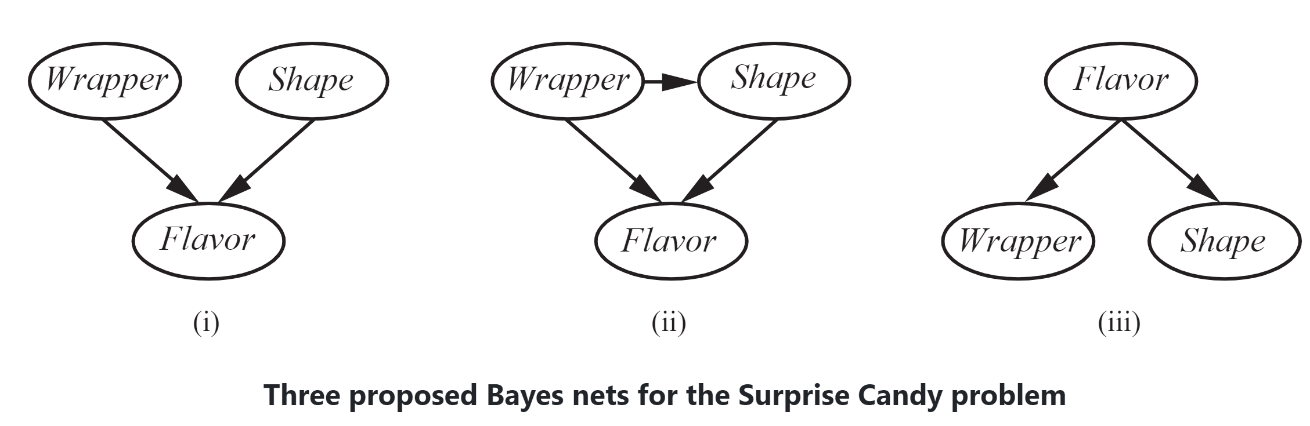
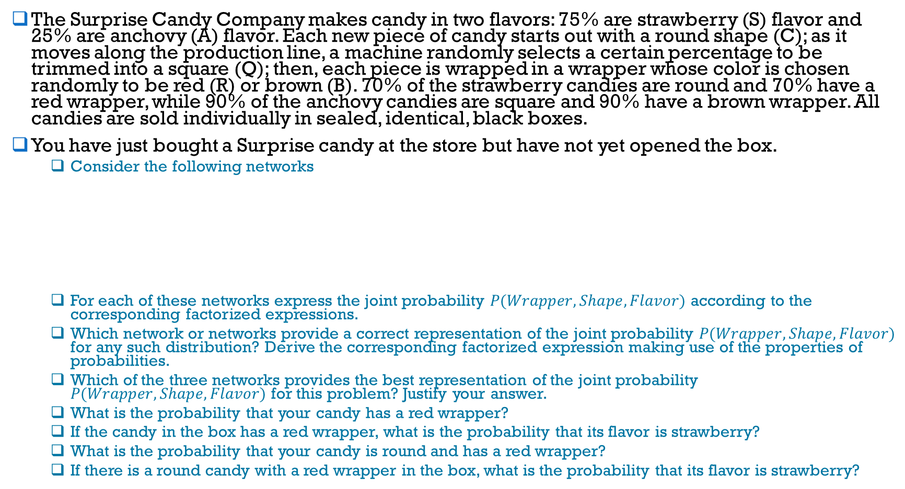
3. Probability and Bayesian networks
The Surprise Candy Company makes candy in two flavors: 75% are strawberry (S) flavor and 25% are anchovy (A) flavor. Each new piece of candy starts out with a round shape (C); as it moves along the production line, a machine randomly selects a certain percentage to be trimmed into a square (Q); then, each piece is wrapped in a wrapper whose color is chosen randomly to be red (R) or brown (B). 70% of the strawberry candies are round and 70% have a red wrapper, while 90% of the anchovy candies are square and 90% have a brown wrapper. All candies are sold individually in sealed, identical, black boxes.
You have just bought a Surprise candy at the store but have not yet opened the box.
Consider the following networks
For each of these networks express the joint probability $P(Wrapper, Shape, Flavor)$ according to the corresponding factorized expressions.
Which network or networks provide a correct representation of the joint probability $P(Wrapper, Shape, Flavor)$ for any such distribution? Derive the corresponding factorized expression making use of the properties of probabilities.
Which of the three networks provides the best representation of the joint probability $P(Wrapper, Shape, Flavor)$ for this problem? Justify your answer.
What is the probability that your candy has a red wrapper?
If the candy in the box has a red wrapper, what is the probability that its flavor is strawberry?
What is the probability that your candy is round and has a red wrapper?
If there is a round candy with a red wrapper in the box, what is the probability that its flavor is strawberry?

Slide 8
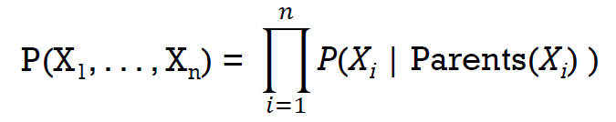
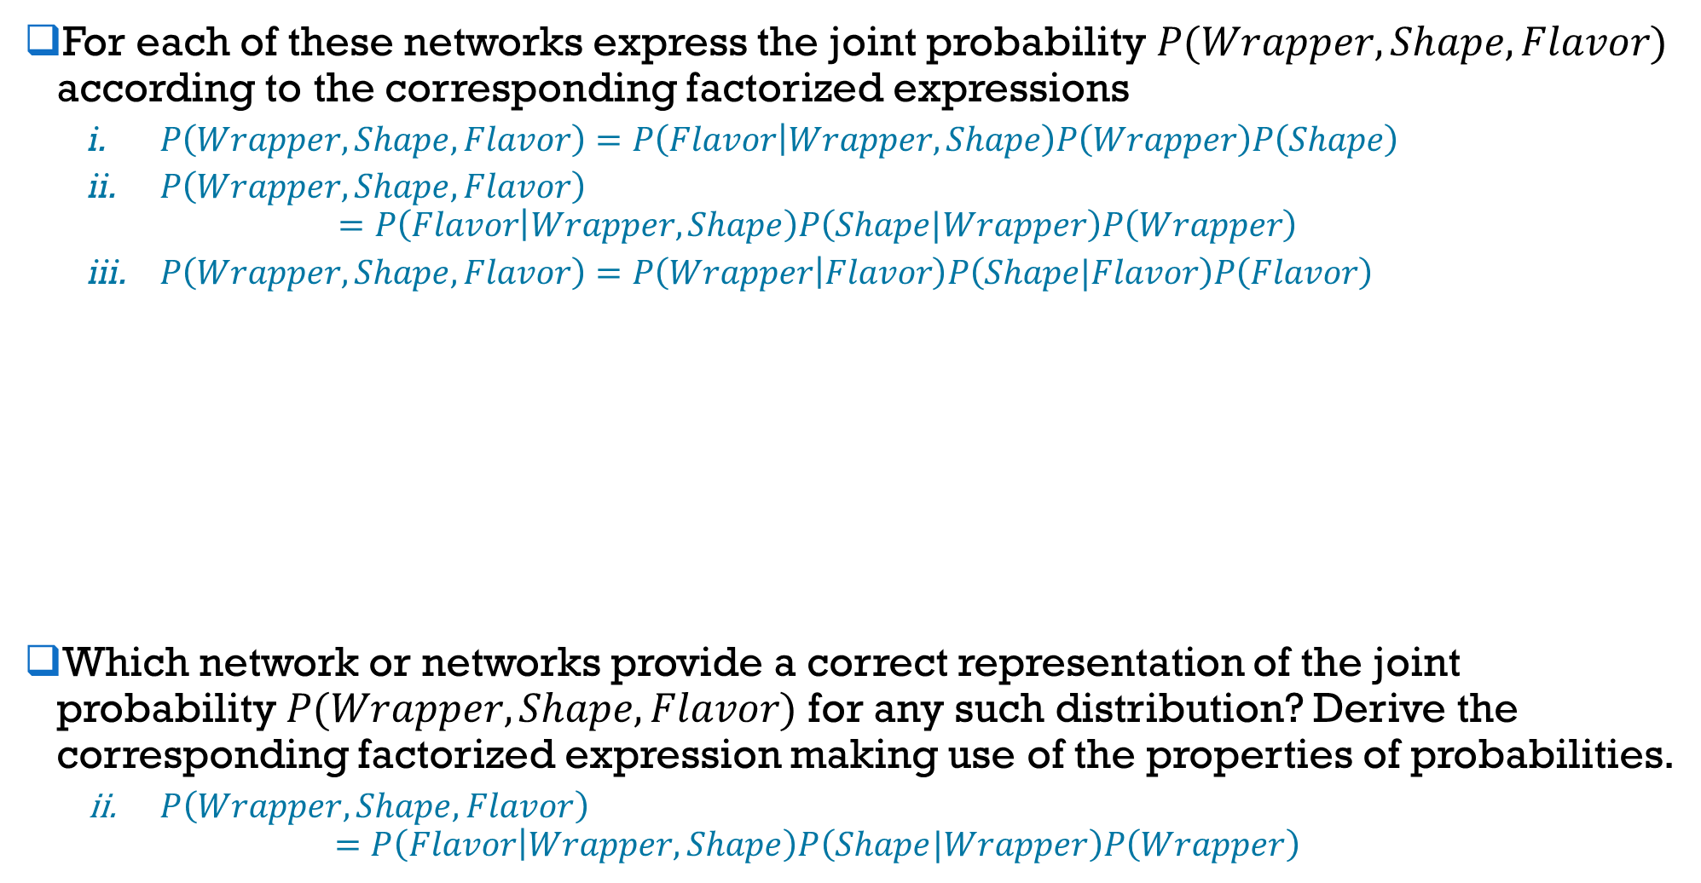
For each of these networks express the joint probability $P(Wrapper, Shape, Flavor)$ according to the corresponding factorized expressions
$P\left(Wrapper, Shape, Flavor\right)=P\left(Flavor | Wrapper, Shape\right)P\left(Wrapper\right)P\left(Shape\right)$
$P\left(Wrapper, Shape, Flavor\right)$
$$=P\left(Flavor | Wrapper, Shape\right)P\left(Shape|Wrapper\right)P\left(Wrapper\right)$$
$P\left(Wrapper, Shape, Flavor\right)=P\left(Wrapper | Flavor\right)P\left(Shape|Flavor\right)P\left(Flavor\right)$
Which network or networks provide a correct representation of the joint probability $P(Wrapper, Shape, Flavor)$ for any such distribution? Derive the corresponding factorized expression making use of the properties of probabilities.
$P\left(Wrapper, Shape, Flavor\right)$
$$=P\left(Flavor | Wrapper, Shape\right)P\left(Shape|Wrapper\right)P\left(Wrapper\right)$$
Bayes networks

Slide 9

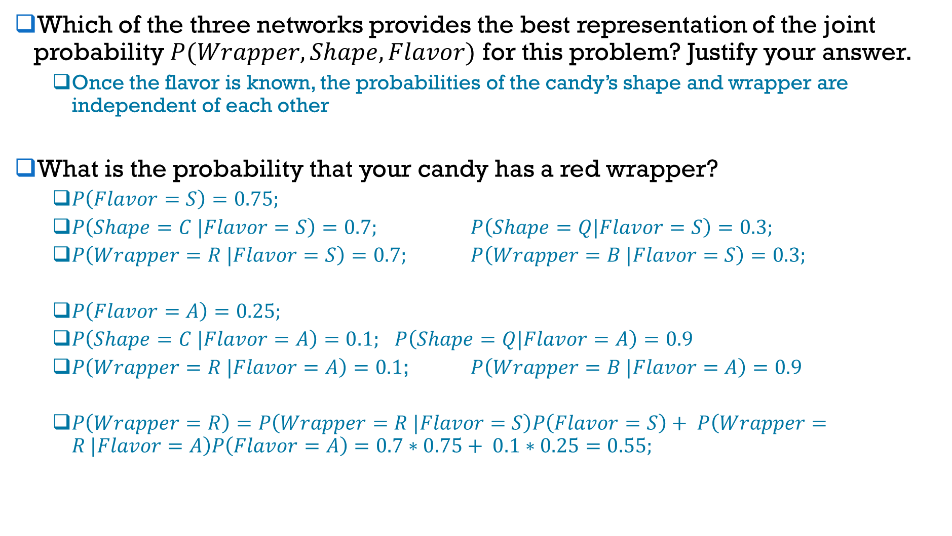
Which of the three networks provides the best representation of the joint probability $P(Wrapper, Shape, Flavor)$ for this problem? Justify your answer.
Once the flavor is known, the probabilities of the candy’s shape and wrapper are independent of each other
What is the probability that your candy has a red wrapper?
$P\left(Flavor=S\right)=0.75;$
$P\left(Shape=C |Flavor=S\right)=0.7;$ $P\left(Shape=Q|Flavor=S\right)=0.3;$
$P\left(Wrapper=R |Flavor=S\right)=0.7;$ $P\left(Wrapper=B |Flavor=S\right)=0.3;$
$P\left(Flavor=A\right)=0.25;$
$P\left(Shape=C |Flavor=A\right)=0.1;$ $P\left(Shape=Q|Flavor=A\right)=0.9$
$P\left(Wrapper=R |Flavor=A\right)=0.1$; $P\left(Wrapper=B |Flavor=A\right)=0.9$
$P\left(Wrapper=R\right)=P\left(Wrapper=R |Flavor=S\right)P\left(Flavor=S\right)+ P\left(Wrapper=R |Flavor=A\right)P\left(Flavor=A\right)=0.7∗0.75+ 0.1∗0.25=0.55;$
Law of total probability

Slide 10
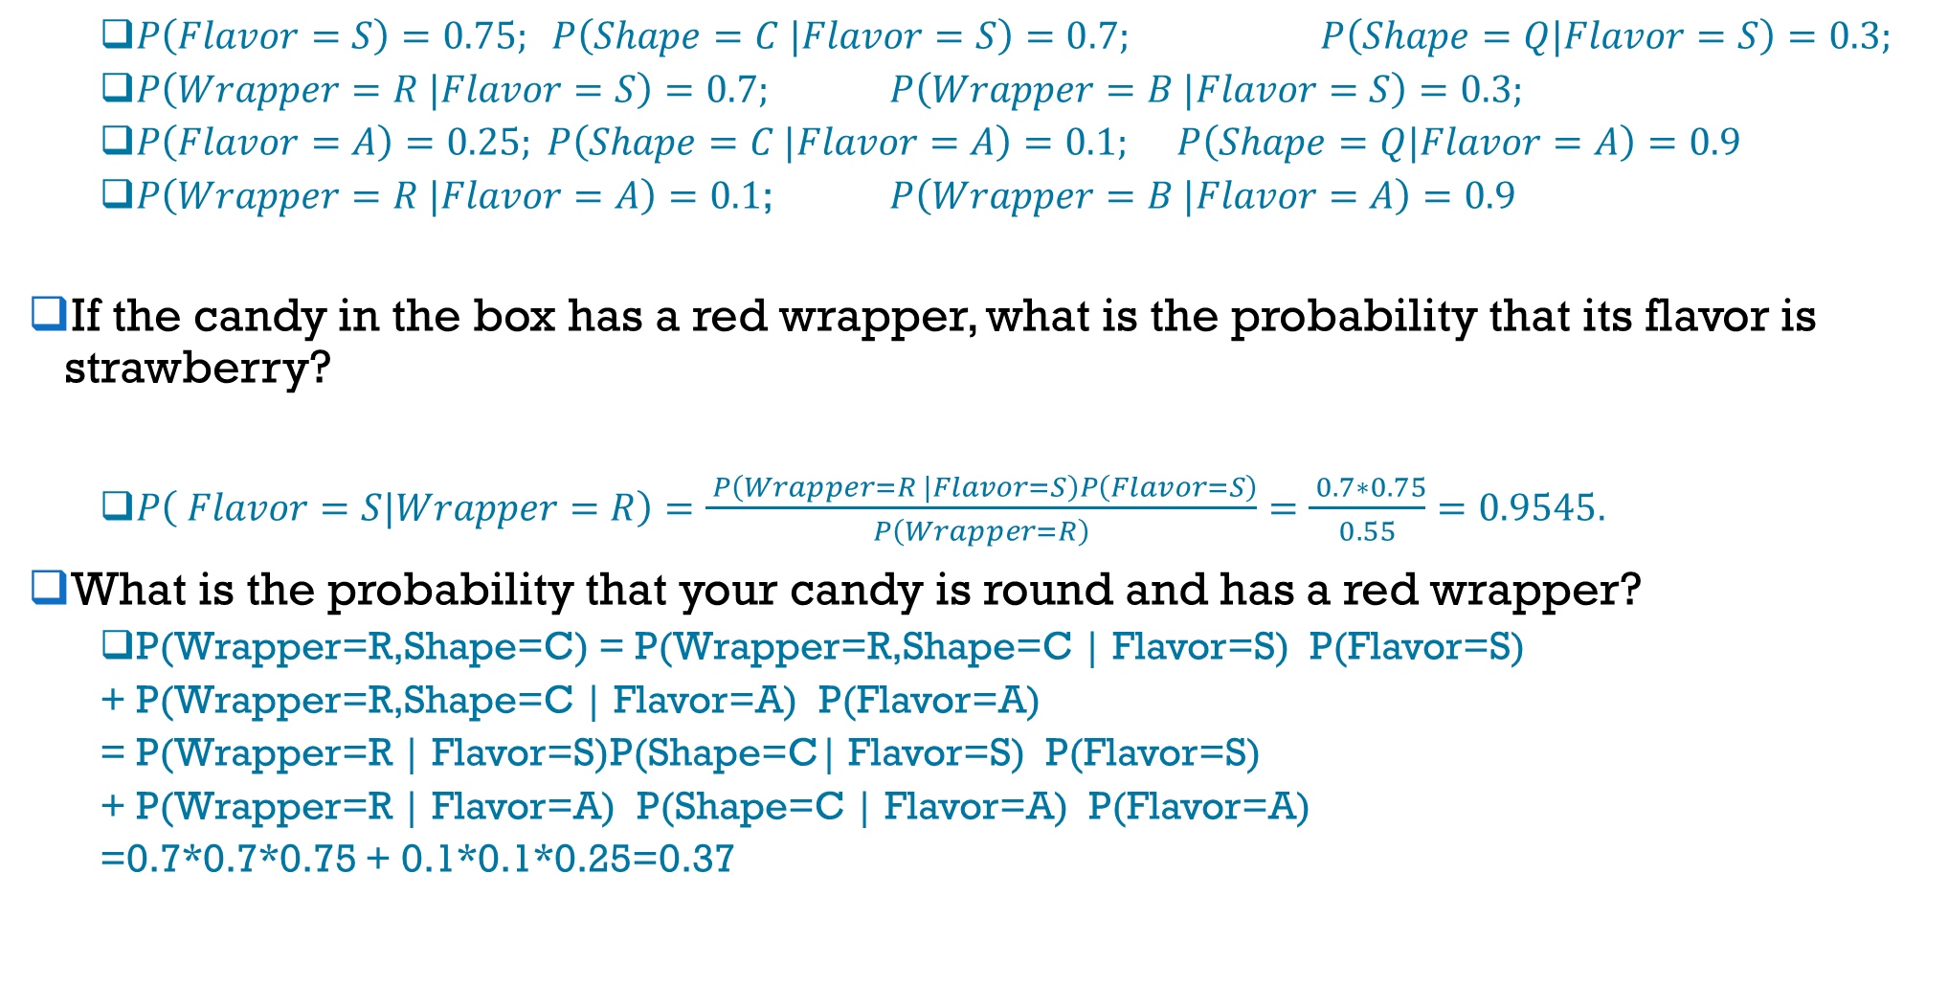
$P\left(Flavor=S\right)=0.75; P\left(Shape=C |Flavor=S\right)=0.7;$ $P\left(Shape=Q|Flavor=S\right)=0.3;$
$P\left(Wrapper=R |Flavor=S\right)=0.7;$ $P\left(Wrapper=B |Flavor=S\right)=0.3;$
$P\left(Flavor=A\right)=0.25; P\left(Shape=C |Flavor=A\right)=0.1;$ $P\left(Shape=Q|Flavor=A\right)=0.9$
$P\left(Wrapper=R |Flavor=A\right)=0.1$; $P\left(Wrapper=B |Flavor=A\right)=0.9$
If the candy in the box has a red wrapper, what is the probability that its flavor is strawberry?
$P\left( Flavor=S|Wrapper=R\right)=\frac{ P\left(Wrapper=R |Flavor=S\right)P\left(Flavor=S\right)}{P\left(Wrapper=R\right)}=\frac{ 0.7∗0.75}{0.55}=0.9545.$
What is the probability that your candy is round and has a red wrapper?
P(Wrapper=R,Shape=C) = P(Wrapper=R,Shape=C | Flavor=S) P(Flavor=S)
+ P(Wrapper=R,Shape=C | Flavor=A) P(Flavor=A)
= P(Wrapper=R | Flavor=S)P(Shape=C| Flavor=S) P(Flavor=S)
+ P(Wrapper=R | Flavor=A) P(Shape=C | Flavor=A) P(Flavor=A)
=0.7*0.7*0.75 + 0.1*0.1*0.25=0.37
Law of total probability

Slide 11
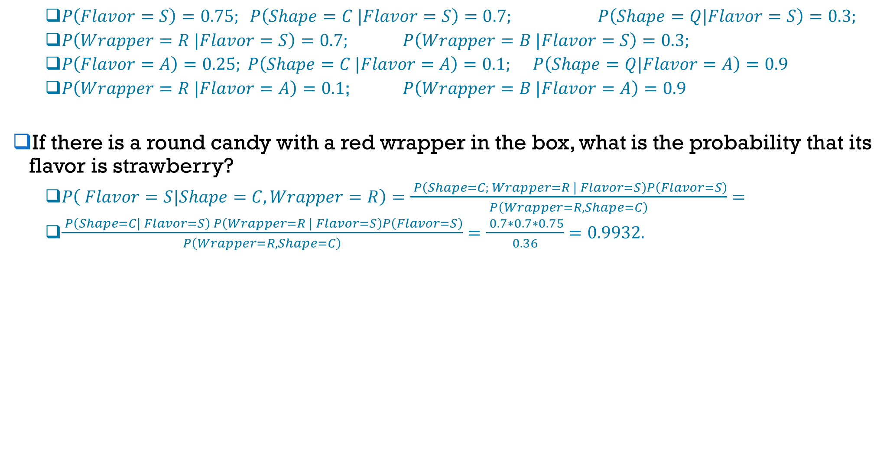
$P\left(Flavor=S\right)=0.75; P\left(Shape=C |Flavor=S\right)=0.7;$ $P\left(Shape=Q|Flavor=S\right)=0.3;$
$P\left(Wrapper=R |Flavor=S\right)=0.7;$ $P\left(Wrapper=B |Flavor=S\right)=0.3;$
$P\left(Flavor=A\right)=0.25; P\left(Shape=C |Flavor=A\right)=0.1;$ $P\left(Shape=Q|Flavor=A\right)=0.9$
$P\left(Wrapper=R |Flavor=A\right)=0.1$; $P\left(Wrapper=B |Flavor=A\right)=0.9$
If there is a round candy with a red wrapper in the box, what is the probability that its flavor is strawberry?
$P\left( Flavor=S|Shape=C, Wrapper=R\right)=\frac{ P\left(Shape=C; Wrapper=R | Flavor=S\right)P\left(Flavor=S\right)}{P\left(Wrapper=R, Shape=C\right)}=$
$\frac{ P\left(Shape=C| Flavor=S\right) P\left(Wrapper=R | Flavor=S\right)P\left(Flavor=S\right)}{P\left(Wrapper=R, Shape=C\right)}=\frac{ 0.7∗0.7∗0.75}{0.36}=0.9932.$
Bayes theorem
Bayes networks

